Slide 1


Systems Analysis and Design with UML
Alan Dennis, Barbara Haley Wixom, and David Tegarden
Chapter 7: Structural Modeling
John Wiley & Sons, Inc.
Copyright 2010

Slide 2
Purpose of Structural Models
A structural or conceptual model describes the structure of the data that supports the business processes in an organization
Reduce the “semantic gap” between the real world and the world of software
Represent things, ideas, and concepts of importance in the application domain
Create a vocabulary for analysts and users

Slide 3
Class
A Class diagram gives an overview of a system by showing its classes and the relationships among them
Class diagrams are static - they display what interacts
but not what happens when they do interact.
Class Name
WashingMachine
Attributes
+ modelName: String
- serialNumber : Integer
# capacity : Integer
Operations
+ addClothes( )
+ removeClothes( )
+ addDetergent( )
+ turnOn( )
Taking dirty clothes as input and
producing clean clothes as output
Responsibility
(Optional)

Slide 4
Attribute
Syntax
[visibility] name : type-expression [= initial-value]
Visibility
public : +
private : -
protected : #
Example
+ modelName : String
- modelRegNum : Integer = 10
# accessCount : Integer
(meanings ?)
WashingMachine
+ modelName: String
- serialNumber : Integer
# capacity : Integer

Slide 5
Operation
Syntax
[visibility] name [(parameter-list)][: return-type]
Example
UML Style
+ addClothes(n : Cloth)
+ getClothes(index : int) : Cloth
- test()
Java Style
+ void addClothes(Cloth n)
+ Cloth getClothes(int index)
WashingMachine
+ addClothes( )
+ removeClothes( )
+ addDetergent( )
+ turnOn( )

Slide 6
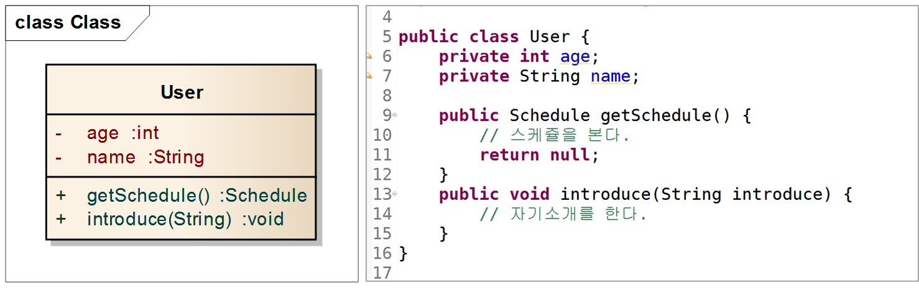

Slide 7
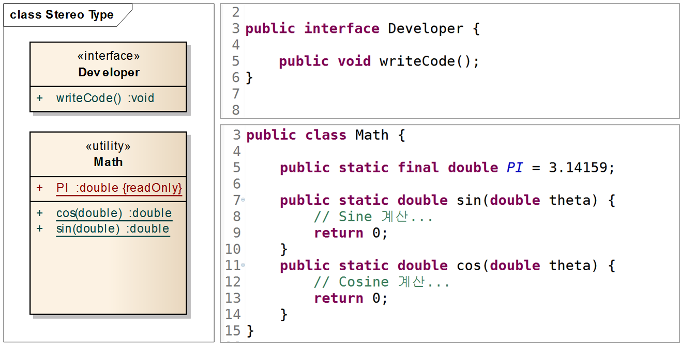
Stereo Type

Slide 8
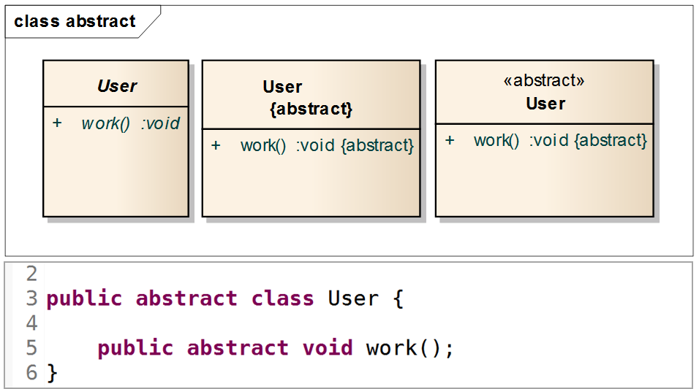
Abstract Class/Method

Slide 9
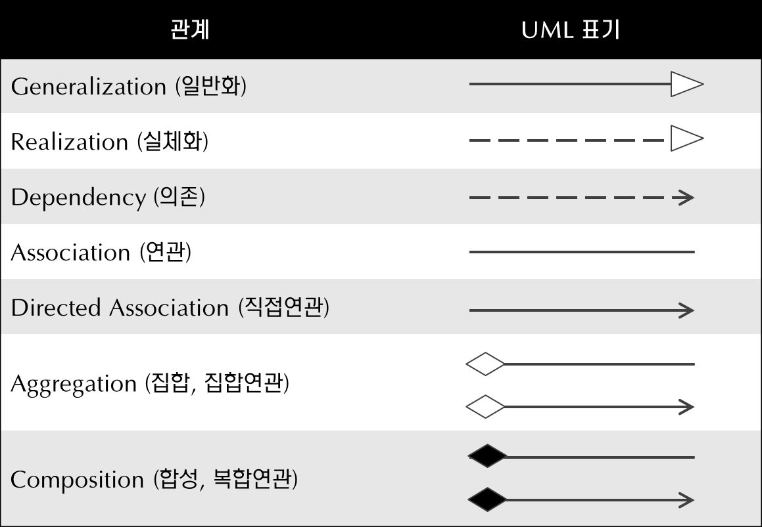
클래스 사이의 관계

Slide 10
Generalization I
Generalization (또는 Inheritance)
부모-자식간의 관계 (IS-A)를 나타낸다.
자식은 부모의 특성을 모두 이용할 수 있다.
PPPP
aaa : int
# bb : String
op1()
+ op2() : String
# op3()
CCCCC
+ op4()

Slide 11
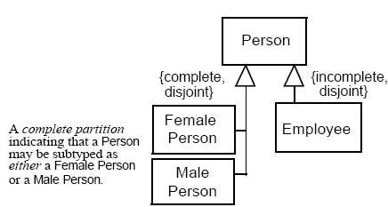
Generalization의 예

Slide 12
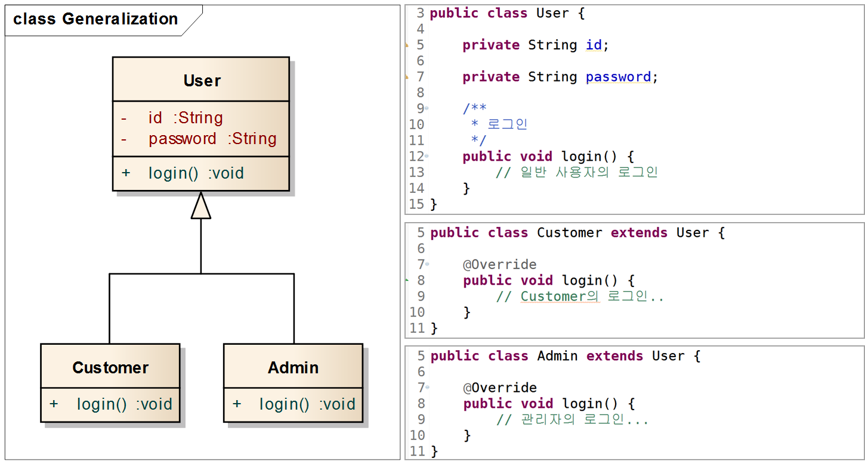

Slide 13
Generalizations II
Abstract vs. Concrete Class
Abstract class
does not have any objects
has at least one abstract operations
abstract operation : has no implementation method
Concrete class
has implementations for all operations
has objects
Vehicle
{abstract}
Vehicle
(italic name)
color
drive( ){abstract}
drive() starts
the propeller
drive() starts
the wheels
Car
Boat
Truck
drive( )
drive( )
drive( )

Slide 14
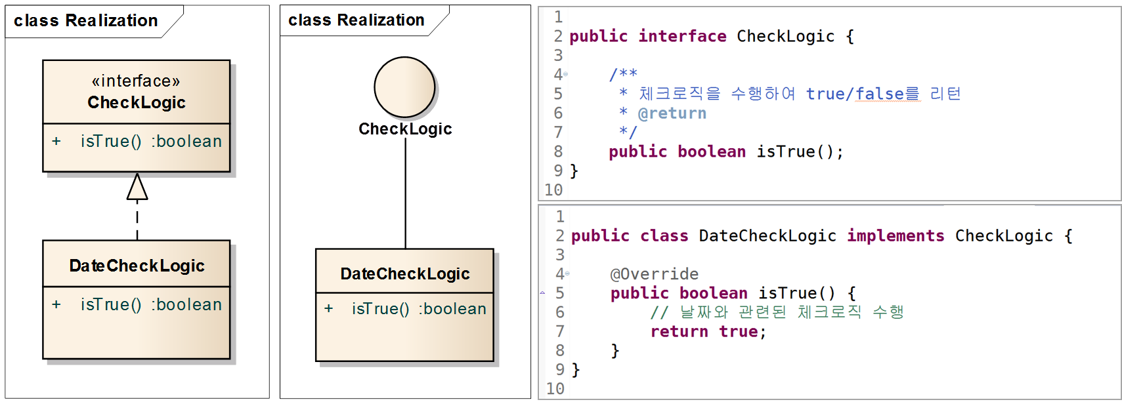
Realization(실체화)

Slide 15
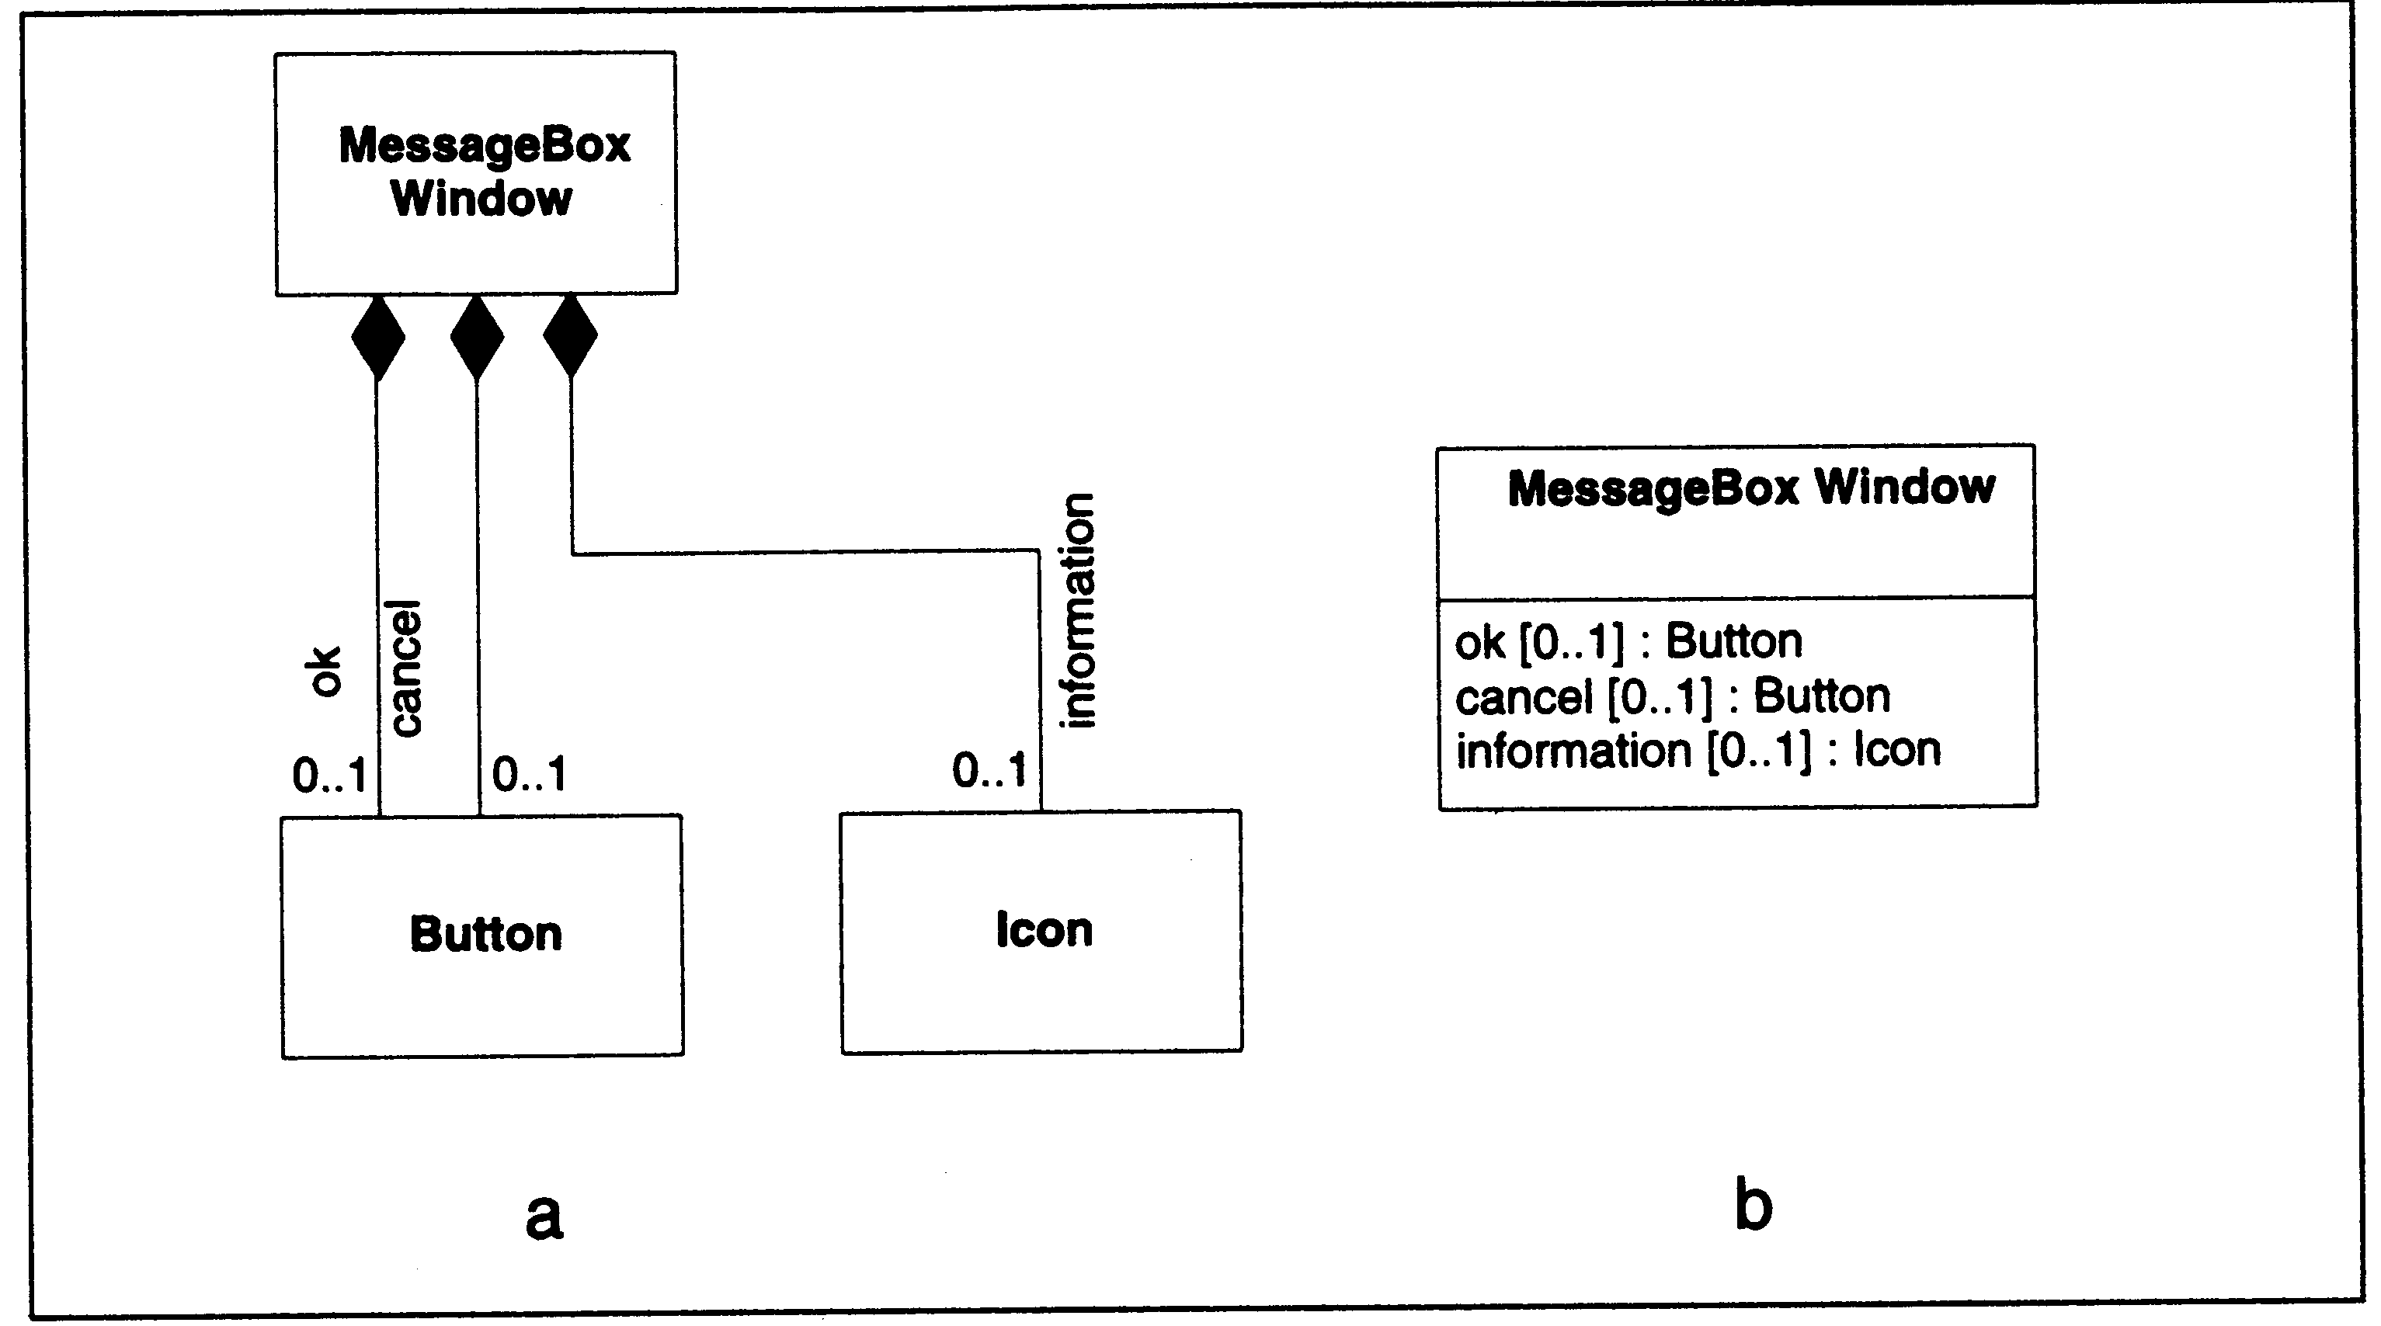
Aggregation : Composition (1)
Strong Aggregation (composition)
전체와 부분관계(Part-Of)를 말한다.
전체는 부분들의 모임으로 정의된다.
전체와 부분은 동시에 생성/소멸된다.
Whole
Part

Slide 16
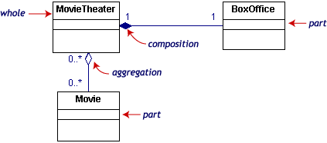
Aggregation (2)
Weak Aggregation
전체와 부분관계(Part-Of)를 말한다.
전체는 부분들의 모임으로 정의된다.
다른 전체에 공유될 수 있다.
Whole
Part

Slide 17
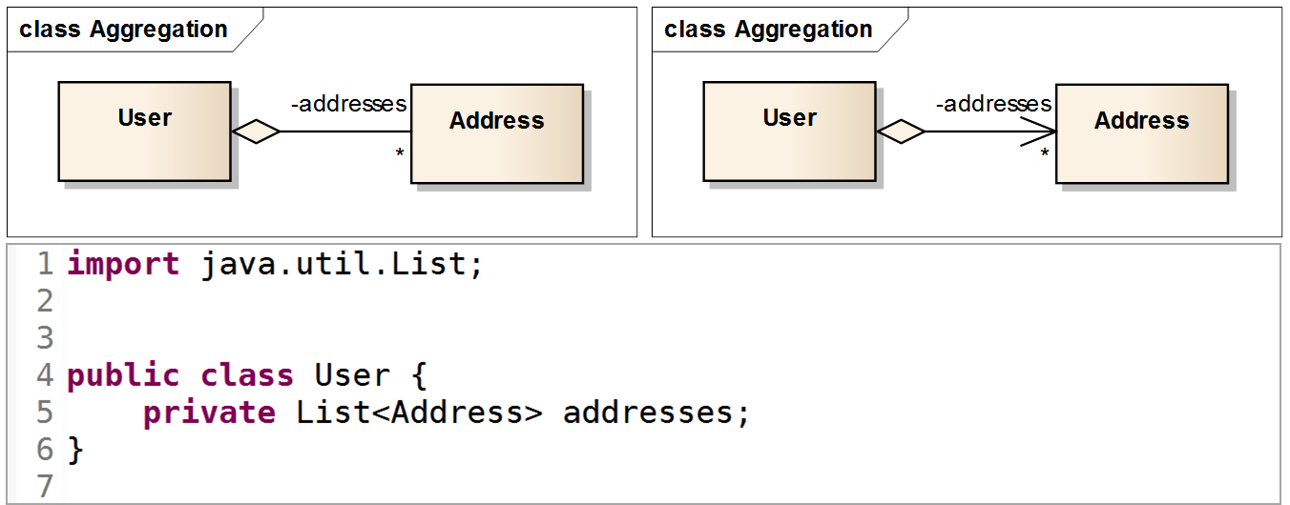

Slide 18
Association (I)
Association
클래스간의 연관성이 있음을 나타낸다.
연관성의 방향을 나타내는 navigability를 가진다.
Role name으로 클래스간의 관계를 명확히 할 수 있다.
Association은 기본적으로 연관된 객체의 수를 나타내는 multiplicity를 가진다.
0, 0..*
1, 1..*
*, 2..*
Author
uses
Computer
1
1..*

Slide 19
Association Example I
1..*
1..*
Person
Car
Node
connect
1..*
1..*
Person
Car
parent
driver
company
car
Node
connect
child

Slide 20
Association Example II

Slide 21
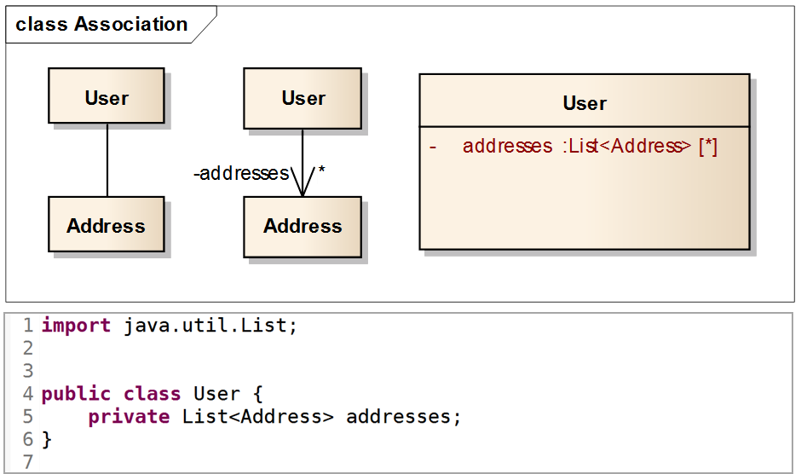
Association

Slide 22
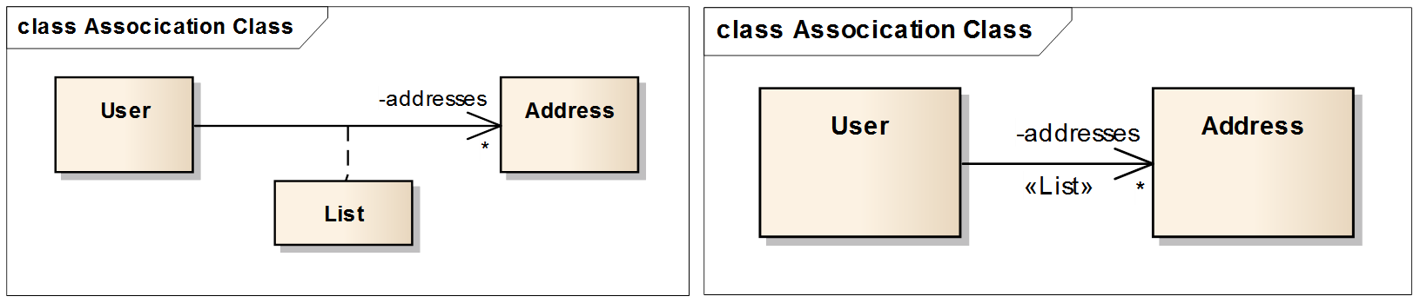

Slide 23
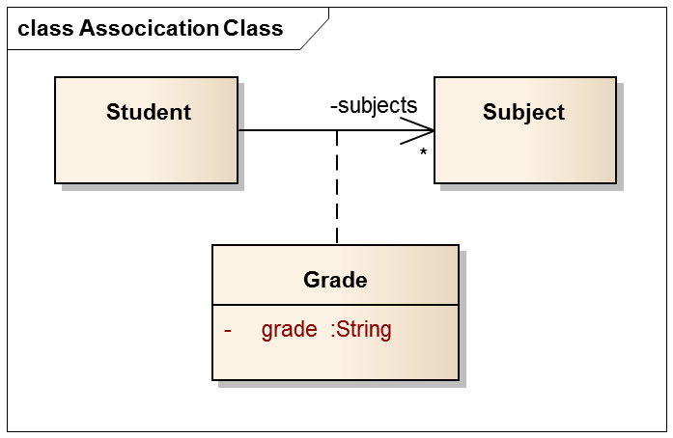

Slide 24
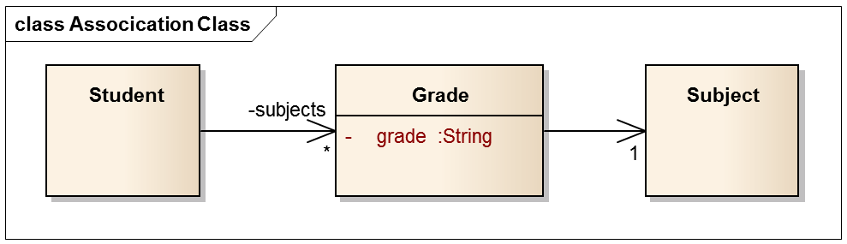

Slide 25
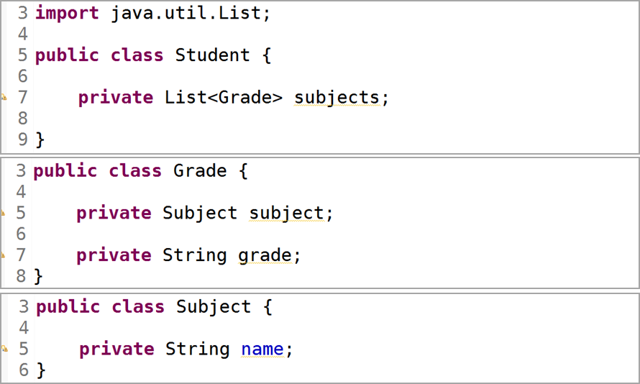

Slide 26
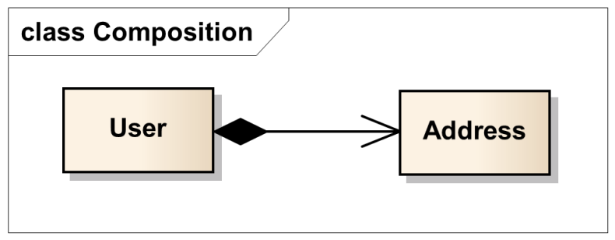
Composition (Composite Aggregation, 합성)
Composition
part가 whole에 종속적이어서 part가 whole의 소유입니다. 반면 Aggregation은 part가 whole에 대해 독립적이어서 whole이 part를 빌려 쓰는 것

Slide 27
첫 번째, part를 가지는 whole 인스턴스가 part 인스턴스의 전체 수명을 책임진다.
whole 인스턴스가 part 인스턴스를 생성
whole 인스턴스가 소멸되면 part 인스턴스도 함께 소멸
whole 인스턴스가 복사되면 part 인스턴스도 함께 복사
두 번째, part에 해당하는 인스턴스는 공유 될 수 없다.

Slide 28
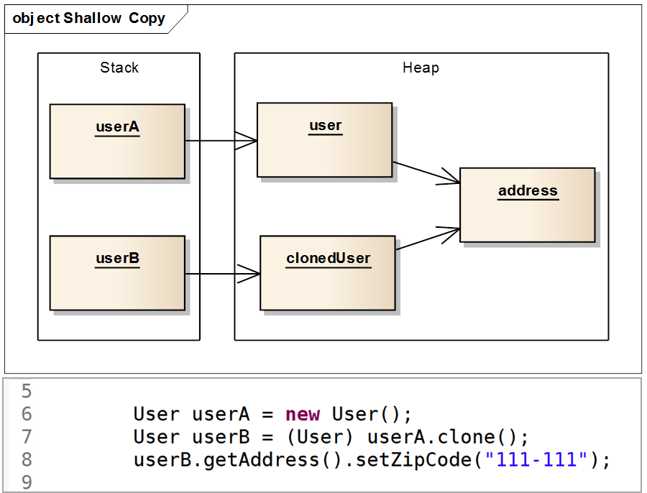
Composition Part 인스턴스 공유 불가

Slide 29
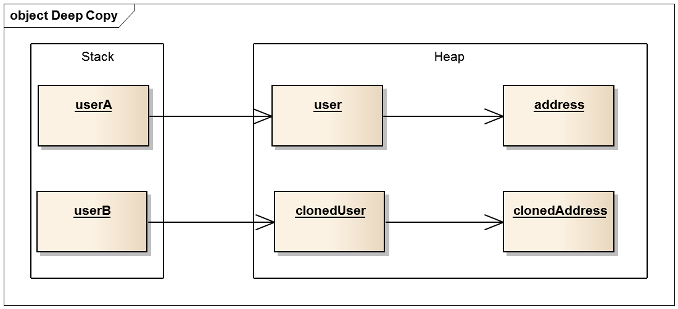
Deep Copy Object Diagram

Slide 30
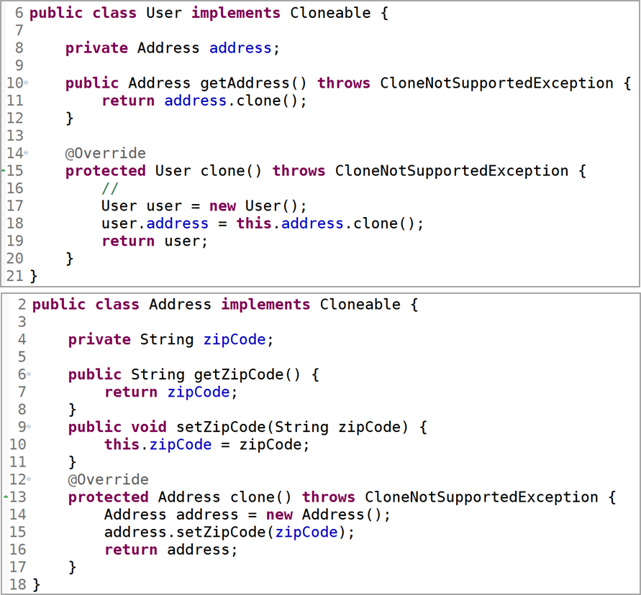
Deep Copy Code

Slide 31
Class Diagram Example I
mn
Controls
2m-2
Controls
1
1
1
Controls
n

Slide 32
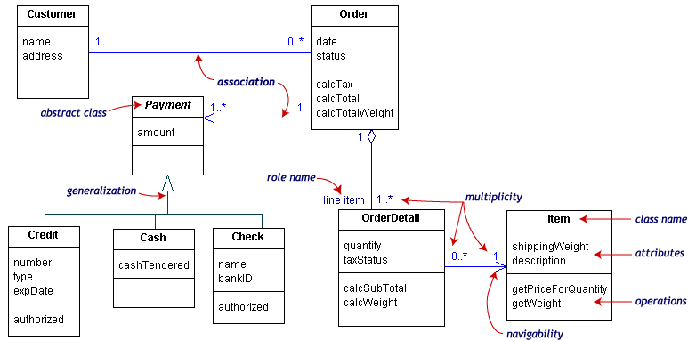
Class Diagram Example II

Slide 33
Dependency and Constraints
Dependency
is a relation between two classes in which a change in one may force changes in the other
Dependencies are drawn as dotted lines.
Constraints
a condition that every implementation of the design must satisfy.
Constraints are written in curly braces { }.

Slide 34
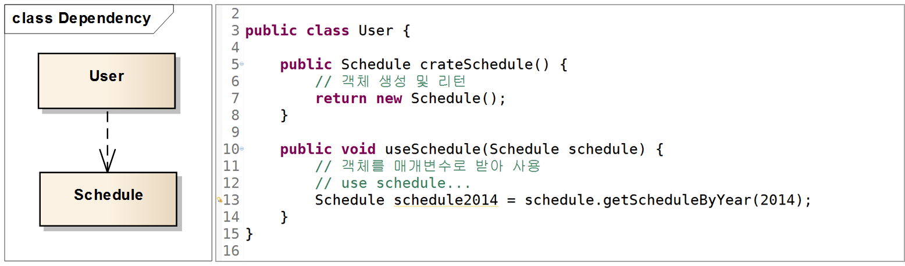
Dependency
Dependency
클래스 다이어그램에서 일반적으로 제일 많이 사용되는 관계로서, 어떤 클래스가 다른 클래스를 참조

Slide 35
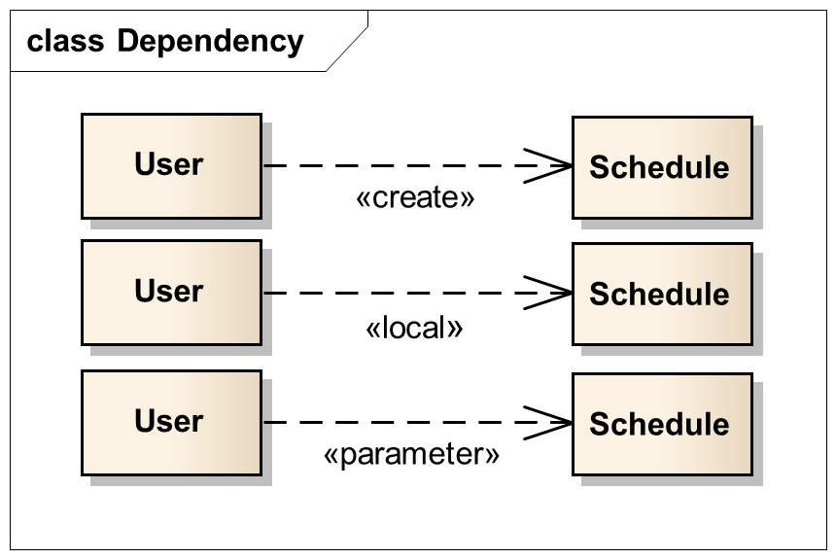
Dependency
Dependency
클래스 다이어그램에서 일반적으로 제일 많이 사용되는 관계로서, 어떤 클래스가 다른 클래스를 참조

Slide 36
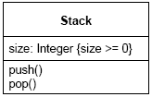
Constraints Example

Slide 37
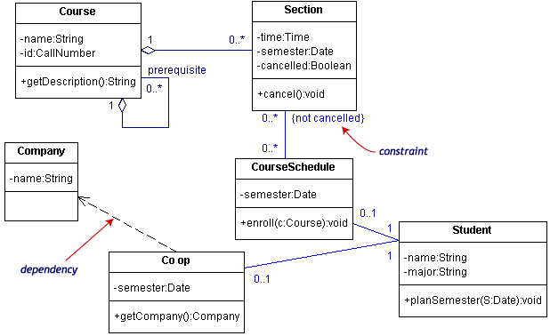
Dependency and Constraints의 예

Slide 38
Interface and stereotypes
Interface
is a set of operation signatures
In C++, interfaces are implemented as abstract classes with only pure virtual members.
Stereotype
provide a way of extending UML
are new kinds of model elements created from existing kinds.
<<interface>>
Storable
Person
Storable
load( )
save( )

Slide 39
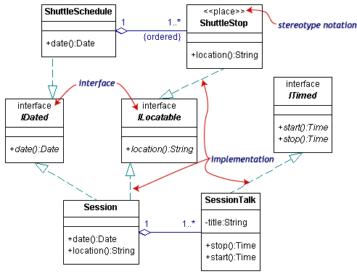
Interface and Stereotypes 의 예 I

Slide 40
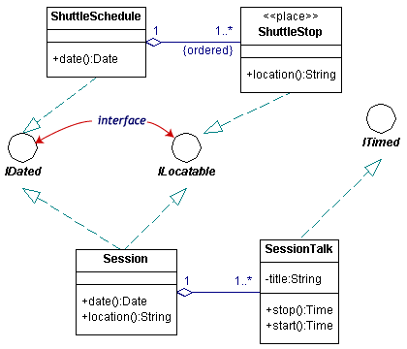
Interface and Stereotypes 의 예 II

Slide 41
CREATING CRC CARDS AND CLASS DIAGRAMS

Slide 42
Responsibilities and Collaborations
Responsibilities
Knowing
Knows the values of its attributes and its relationships
Doing
Execute its operations
Collaboration
Objects working together to service a request

Slide 43
Object Identification
Textual analysis of use-case information
Nouns suggest classes
Verbs suggest operations
Common object list
Tangible things
Incidents
Events that occur in the business domain
Roles
The people play in the problem
Interaction
A transaction that takes place in the business domain

Slide 44
Patterns
Useful groupings of classes that recur in various situations
Transactions
Transaction class
Transaction line item class
Item class
Location class
Participant class

Slide 45
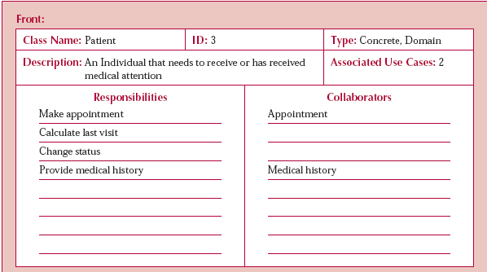
A CRC Card

Slide 46
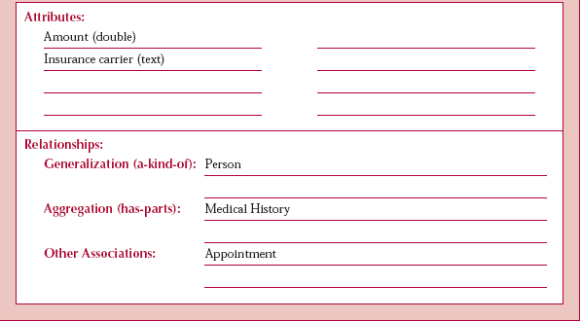
Back of CRC Card

Slide 47
Steps for Object Identification and Structural Modeling
1. Create CRC cards by performing textual analysis on the use-cases.
2. Brainstorm additional candidate classes, attributes, operations, and
relationships by using the common object list approach.
3. Role-play each use-case using the CRC cards.
4. Create the class diagram based on the CRC cards.
5. Review the structural model for missing and/or unnecessary classes,
attributes, operations, and relationships.
6. Incorporate useful patterns.
7. Review the structural model.

